Slide 1
CORPORATE GIFTS
FOOT

Slide 2


FOOT SHAPE ERASER & SHARPENER & PAPERCLIPS

Slide 3

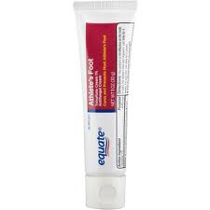


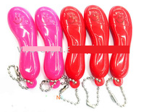
FOOT HIGHLIGHTER & PEN

Slide 4
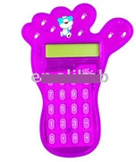
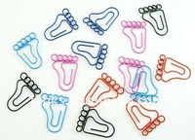
FOOT CALCULATOR & PAPERCLIPS

Slide 5
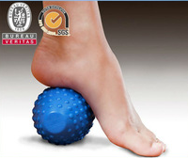
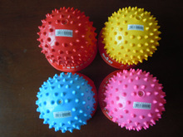



FOOT MASSAGERS

Slide 6
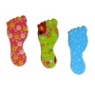


FOOT NAIL FILES & FOOT NOTE PADS

Slide 7
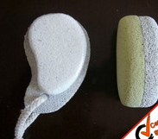


FOOT PUMIC STONES

Slide 8
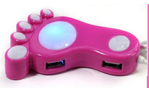

FOOT USB’S

Slide 9
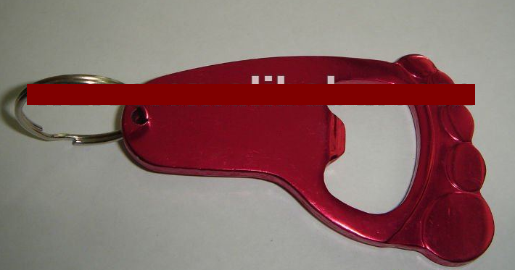
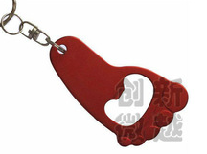

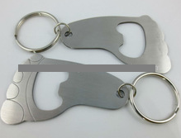

KEYRING BOTTLE OPENERS

Slide 10
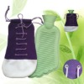

FOOT HOT WATER BOTTLES & WARMERS

Slide 11

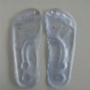
FOOT GEL HEAT PACKS

Slide 12

FOOT PROMOTIONAL RADIO

Slide 13

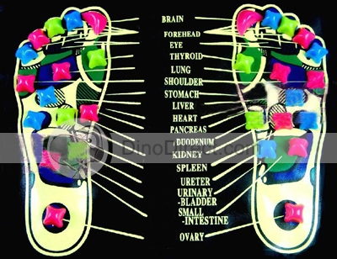

FOOT STRESS RELIEVER & BATH MAT

Slide 14
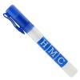
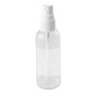
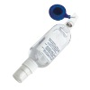
ANTIBACTERIAL FOOT SANATISER & SPRAY

Slide 15
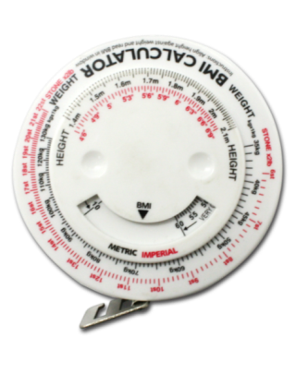
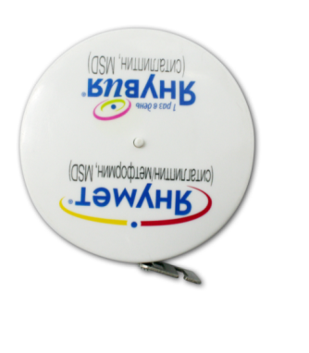
DESKTOP GIFTS
Model | MF0360
Product Name | Round BMI Tape Measure
Description | Large logo area Useful tool for modern people to assess personal fat status
Material | ABS
Size | 7.1*7.1*2.1cm

Slide 16
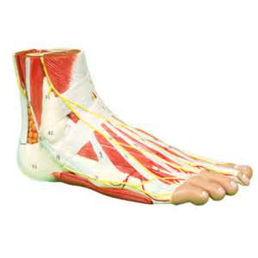
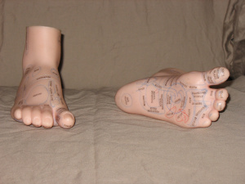
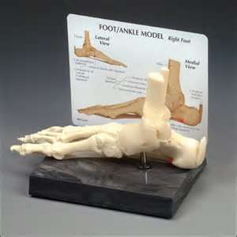
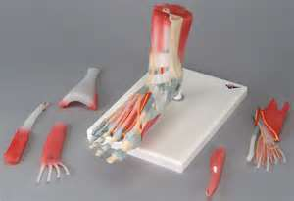
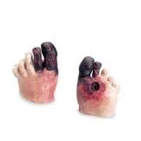
ANATOMICAL MODEL OF THE FOOT

