Slide 1
CORPORATE GIFTS
TOOTH SHAPE ITEMS

Slide 2

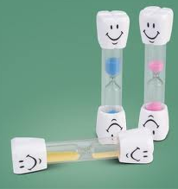
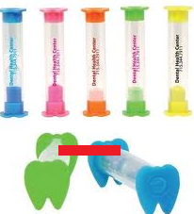
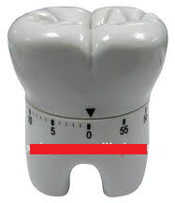

TIMERS

Slide 3
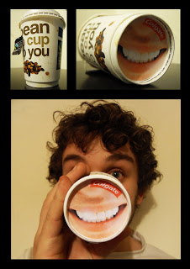
DISPOSABLE COFFEE CUP &

Slide 4
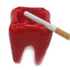


TOOTHSHAPE ASHTRAYS & TOOTHSHAPE SAVINGS BOX

Slide 5

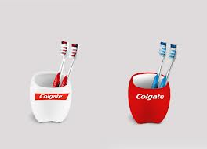
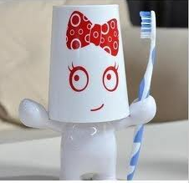
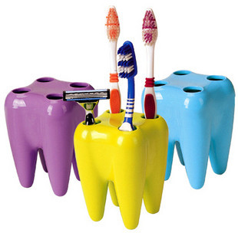
TOOTHBRUSH HOLDERS

Slide 6
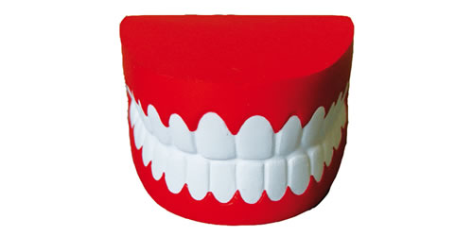




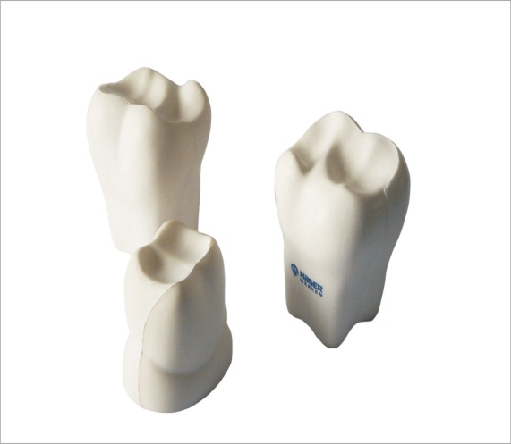
TOOTH SHAPE PU STRESS RELIEVERS

Slide 7
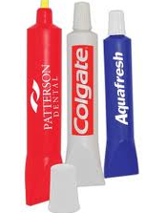




TOOTHPASTE HIGHLIGHTERS, PENS & PENHOLDERS

Slide 8
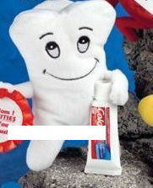
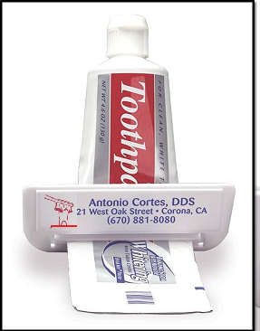
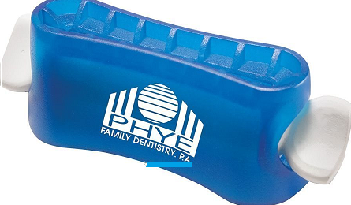


TOOTH SHAPE BEANIES & SQUEEZER

Slide 9

PERSPEX TOOTH &NAME CARD HOLDER

Slide 10







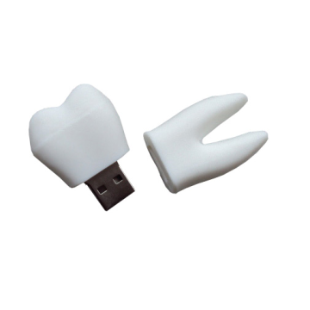
TOOTH & TUBE SHAPE USB FLASHDRIVES

Slide 11
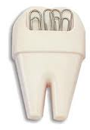


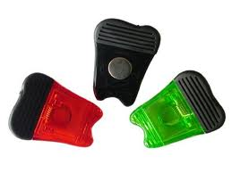
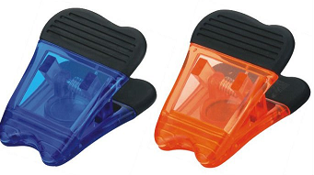
TOOTH SHAPE PAPER CLIP HOLDER & MEMO PEGS

Slide 12
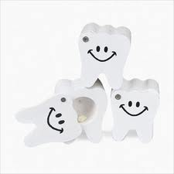
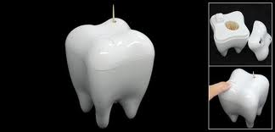


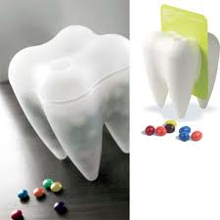
TOOTH SHAPE TOOTHPIC HOLDER, TOOTH BOX, CANDLE HOLDER, MOBILE HOLDER

Slide 13
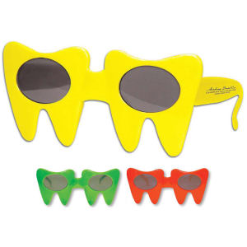
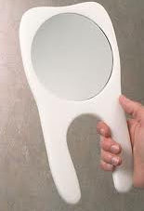
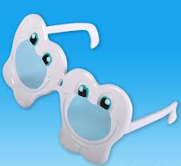
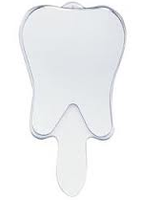


TOOTH SHAPE HAND HELD MIRROR & SUNGLASSES

Slide 14













TOOTH KEYRINGS & LED LIGHTS

Slide 15
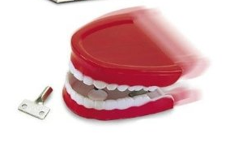



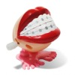

CHATTER TEETH

Slide 16







TOOTH SHAPE WALL CLOCKS

Slide 17
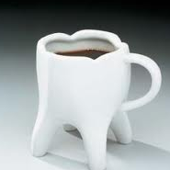


TOOTH SHAPE COFFEE MUGS & DISPOSABLE CUPS

Slide 18
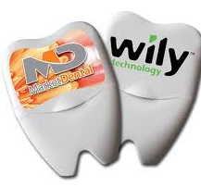
TOOTH SHAPE DENTAL FLOSS

Slide 19
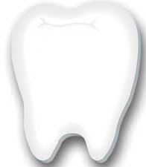
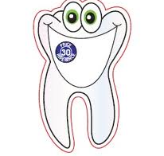
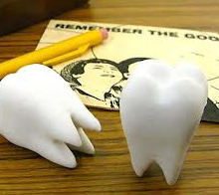
TOOTH SHAPE RESTICK NOTES & TOOTH ERASER

Slide 20
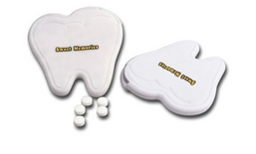
TOOTH SHAPE TINS FILLED WITH MINTS

Slide 21
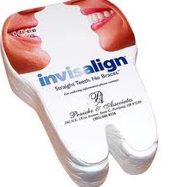
TOOTH SHAPE COMPRESSED T-SHIRT OR HAND TOWEL

Slide 22
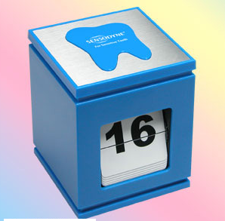
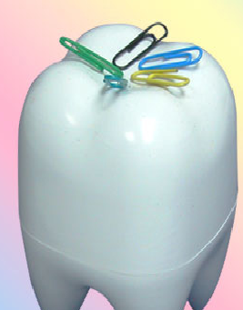
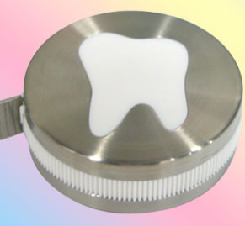
TOOTH SHAPE DESK ITEMS

Slide 23
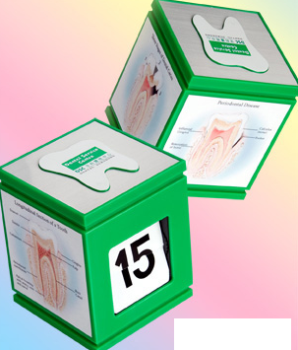
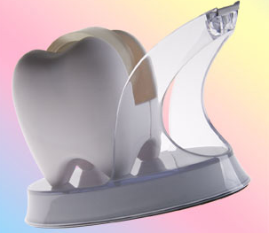
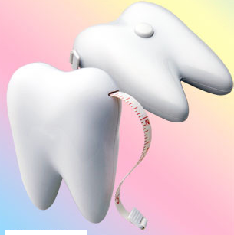
TOOTH SHAPE DESK ITEMS

Slide 24
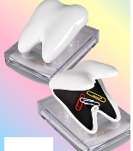
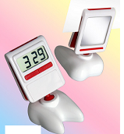
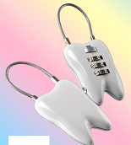
TOOTH SHAPE DESK ITEMS

Slide 25
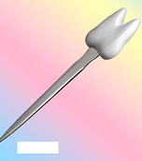
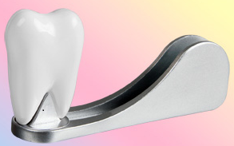
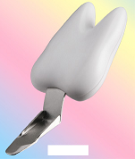
TOTH SHAPE DESK ITEMS

Slide 26

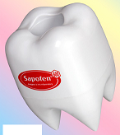
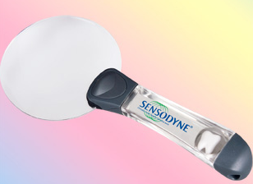
TOOTH SHAPE DESK ITEMS

Slide 27
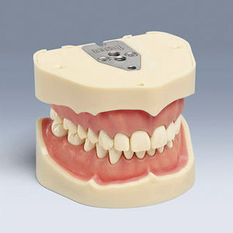
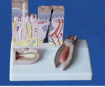


ANATOMICAL TEETH MODELS

