Slide 1
PREGNANCY

Slide 2

CONTRACEPTIVE MODEL

Slide 3

GESTATION MODEL

Slide 4
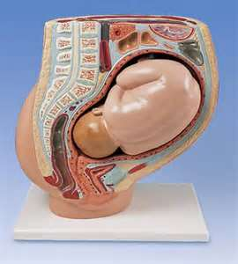
PREGNANCY MODEL

Slide 5

MATERNITY TRAINING MODEL

Slide 6
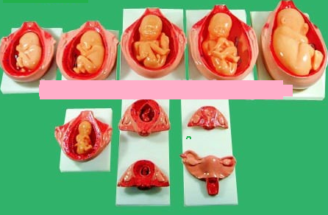
GESTATION MODEL

Slide 7
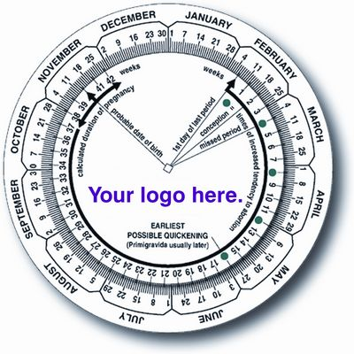

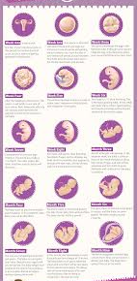
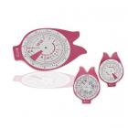
PREGNANCY WHEELS & CALENDARS

Slide 8
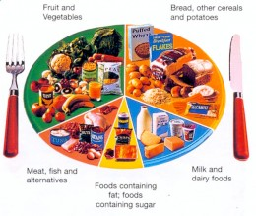
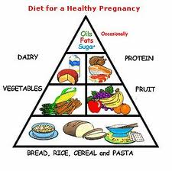
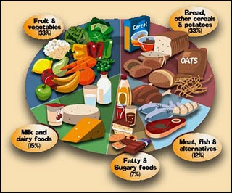
DIET PLANNERS

Slide 9




PREGNANCY CUSHIONS & BELTS

Slide 10
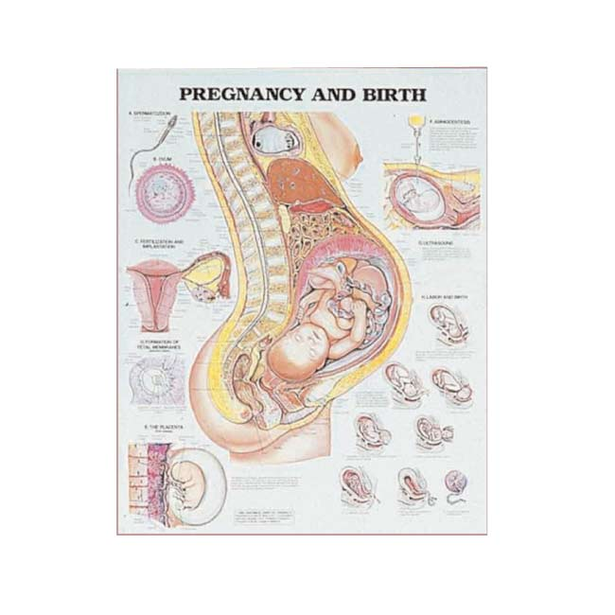
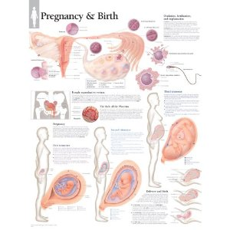
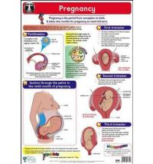
WALL CHARTS

Slide 11

CHILDBIRTH SKILLS TRAINING MODEL

Slide 12



ULTRASOUND MACHINES

Slide 13
BOOKLETS – BROCHURES – ATLAS – WALL CHARTS
A4 & A5 16-32 page Booklets - Various Topics On Pregnancy
DL Brochures – Various Topics On Pregnancy
Mini Pregnancy Atlas
A6 Pregnancy Quick Reference Guides
A5 - 56 page Booklet - 9 Things To Know in Nine Months
Wall Charts – Various on Pregnancy

